Slide 1
GSA’s Vendor and Customer Self Service (VCSS)
Notes:
Hello and welcome to GSA’s Vendor and Customer Self Service (VCSS) training course. This course has been developed to walk you through the navigation and functionality of VCSS. You are listening to Segment 1, Introduction

Slide 2
VCSS Registration Overview
VCSS Account Registration is the process you complete in order to register a VCSS account
The first person that registers the account in VCSS must agree to become the account administrator.
As an account administrator, your responsibilities include approving or disapproving all new user access to the VCSS account.
You can only register one VCSS account at a time.
A User ID must also be created in order to access VCSS
During the approval process for a new VCSS Account registration you can create a new User ID
You can ask GSA to create a User ID to access existing VCSS Accounts
B1
Notes:
The process we are about to cover is geared towards those that are going to register a VCSS account.

Slide 3
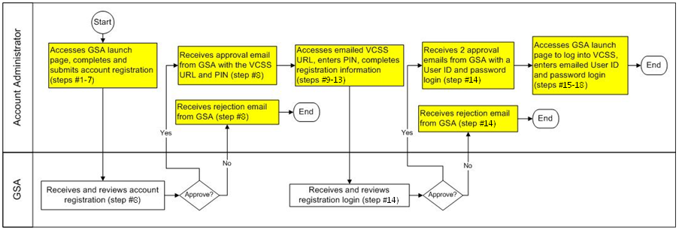
VCSS Registration Process
This is the high level process diagram illustrating the steps to register a VCSS account.
B2
Notes:
Here is the high level process of the steps taken to register for a VCSS account. We are going to review the details for each step in this diagram in the next few slides.
This is a process diagram for the VCSS registration process, which is organized with boxes and rows. Each box represents a step in the registration process. Each row is called a “swim lane” that lists the person responsible for each step.
First, the account administrator accesses the GSA launch page to complete and submit the account registration, which is covered in steps number 1 through 7.
Next, GSA receives and reviews the account registration for approval, which is covered in step number 8.
If GSA approves the account registration, then the account administrator receives an approval email from GSA with the VCSS URL and Personal Identification Number.
However, if GSA does not approve the account registration, then the account administrator receives a rejection email from GSA. Since the account registration has been rejected, the process ends here.
In the case that the account administrator receives an approval email from GSA, then they access the emailed VCSS URL, enter their PIN, and complete the registration information to request a login, which is covered in steps number 9 through 13.
Next, GSA receives and reviews the registration login for approval, which is covered in step number 14.
If GSA approves the login registration, then the account administrator receives two approval emails from GSA. One email contains your new User ID login. The second email contains your password.
However, if GSA does not approve the registration login, then the account administrator receives a rejection email from GSA. Since the login registration has been rejected, the process ends here.
In the case that the account administrator receives the two approval emails from GSA, then they access the GSA launch page to login to VCSS, and then enter their User ID and password in the emails from GSA, which is covered in steps number 13 through 18.

Slide 4
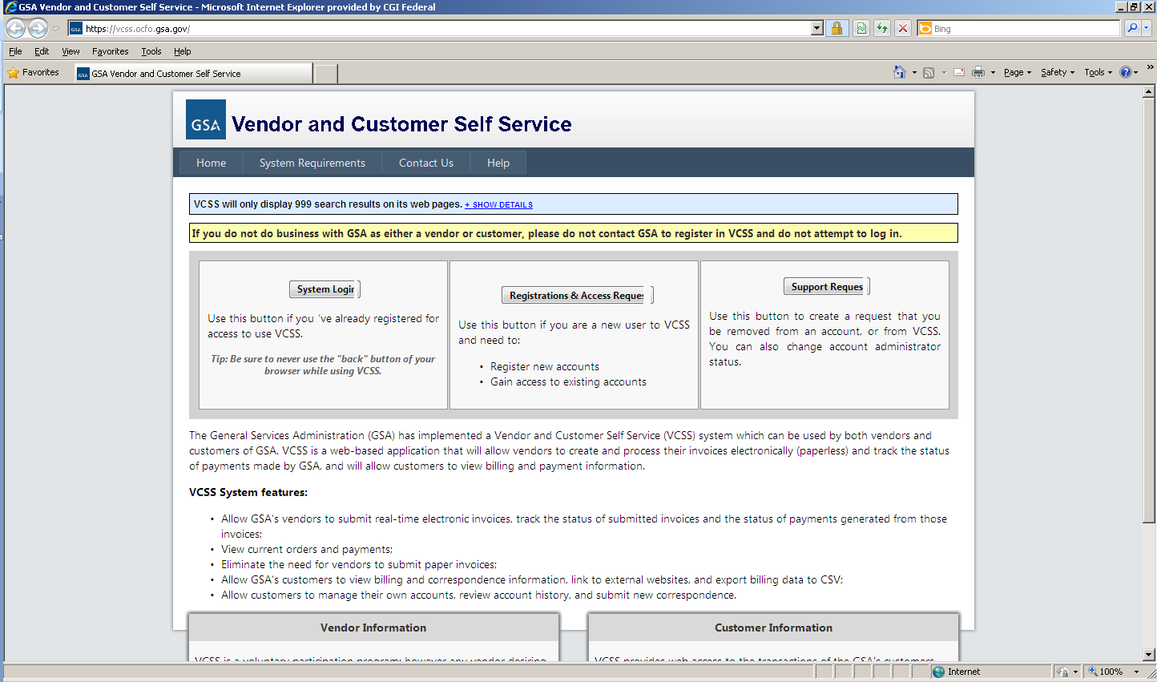
VCSS Registration Steps
To register a VCSS account, perform the following steps covered in the next few slides.
Go to the GSA Launch page (http://vcss.gsa.gov) and select the Registrations and Access Request button to register a VCSS account.
B3
Notes:
We are now going to review the detailed steps of the VCSS account registration process.
First, access the GSA Launch page URL, which is http://vcss.gsa.gov.

Slide 5
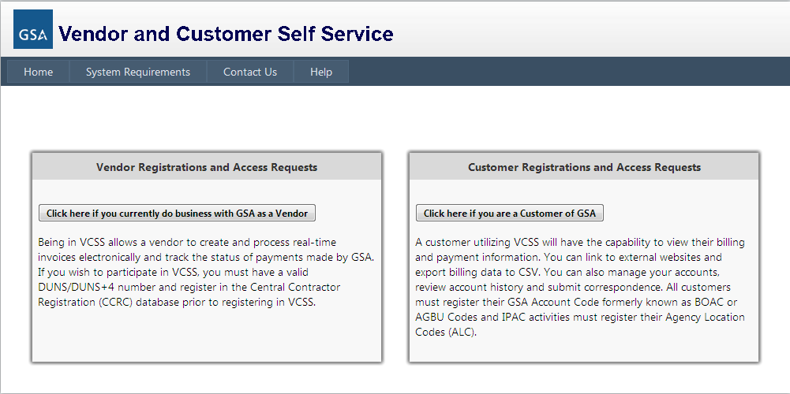
VCSS Registration Steps (Cont’d)
On the GSA launch page, select the Click here if you are a Customer of GSA button to register for a customer account.
B4

Slide 6
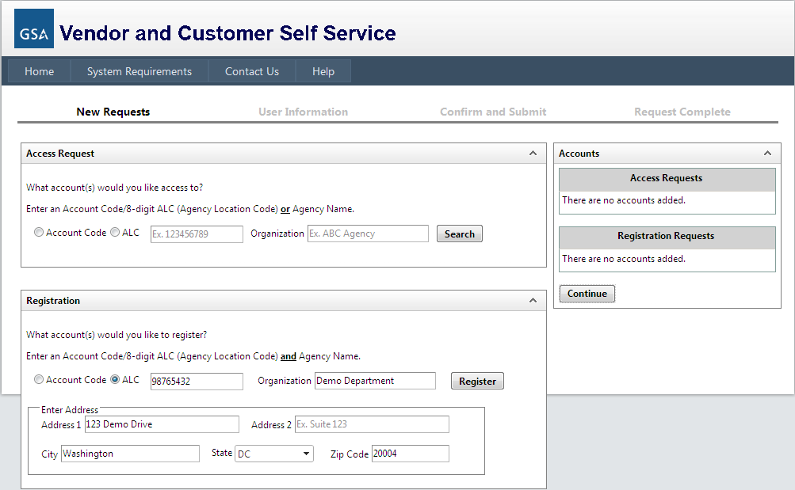
VCSS Registration Steps (Cont’d)
On the next screen of the GSA launch page, in the Registration section, identify the customer you are registering by entering:
Account Code, which you may know as the Billed Office Address Code (BOAC) or Agency Bureau (AB) Code in a legacy system, or,
ALC (Agency Location Code), which is an eight-digit code assigned by Treasury to identify an accounting station within an agency.
Organization Name, which is the name of the customer organization you are registering.
Address Information, which is the address of the customer organization you are registering.
B5

Slide 7
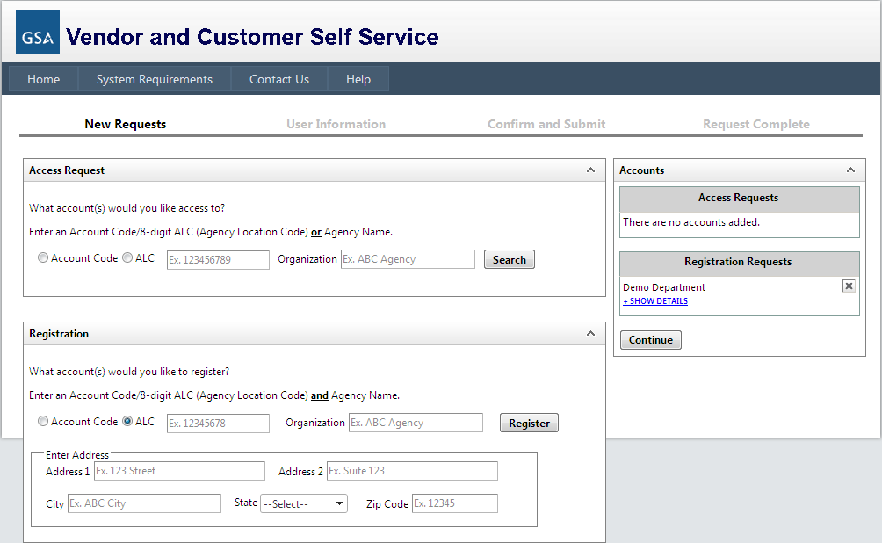
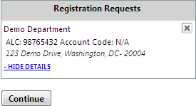
VCSS Registration Steps (Cont’d)
Select the Register button to continue the registration.
The Registration Requests section is populated with the Organization Name you provided in the Registration section.
Select +Show Details to view the details you entered for the registration.
Select the X to remove the registration and start over.
Select the Continue button to continue the registration.
B6

Slide 8
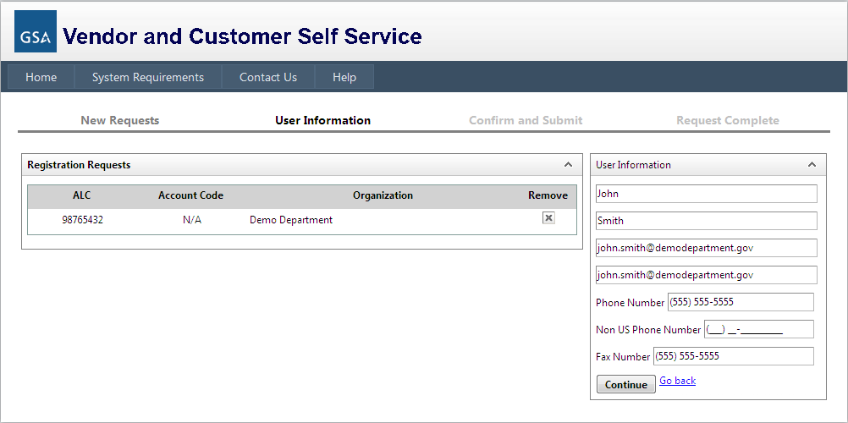
VCSS Registration Steps (Cont’d)
On the next screen of the GSA launch page, fill out the User Information to be associated with the account your are registering.
Select the Continue button to continue the registration.
B7

Slide 9
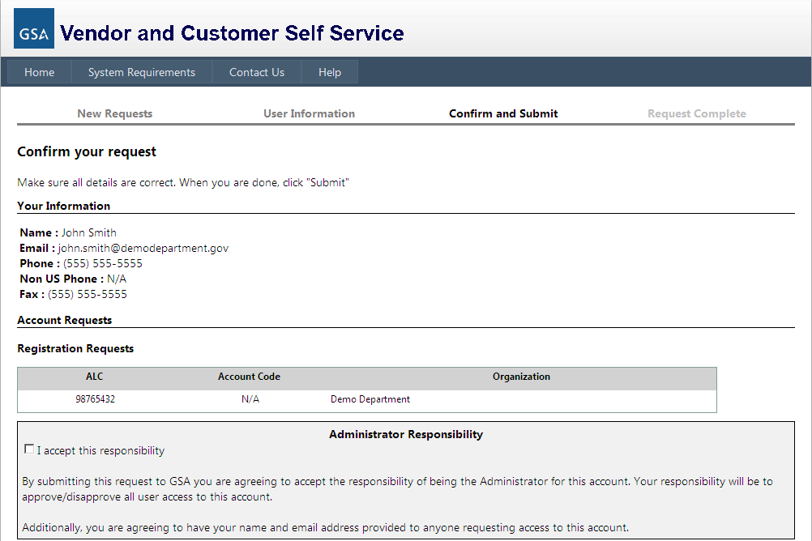
VCSS Registration Steps (Cont’d)
On the next screen of the GSA launch page, review the registration form.
If the information is correct, read the Administrator Responsibility text and select the I accept this responsibility checkbox.
By selecting this checkbox, you are agreeing to become the account administrator of the VCSS account.
B8

Slide 10
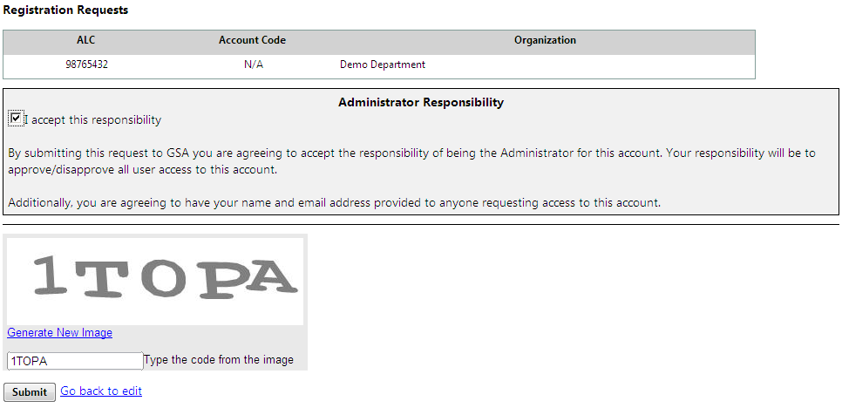
VCSS Registration Steps (Cont’d)
At the bottom of the Confirm and Submit GSA Launch page screen, enter the code from the image and select the Submit button.
B9

Slide 11

VCSS Registration Steps (Cont’d)
GSA
After you submit the registration, GSA is responsible for reviewing and approving the account registration request.
If GSA approves the account registration, GSA will send you an email stating the account registration request is approved and includes a VCSS URL for new registration and a Personal Identification Number (PIN).
If GSA does not approve the account registration, GSA will send you an email stating your account registration request is rejected.
Note: GSA reviews the registration request to ensure there is a valid government email address, except where a government address is not provided to staff.
B10
Notes:
After you submit the account registration, GSA will review your registration request for approval.

Slide 12
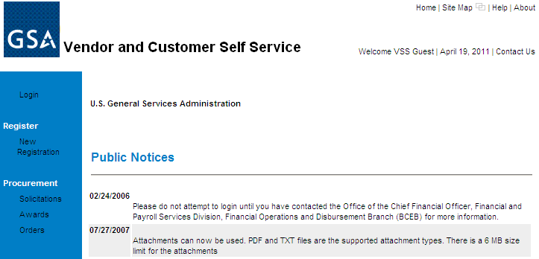
VCSS Registration Steps (Cont’d)
Account Administrator
As the account administrator, open the approval email from GSA and select the VCSS URL for new registration.
On the VCSS main page, select the New Registration hyperlink.
B11
Notes:
You can only follow this step if GSA approved your registration request and sent you an approval email with the VCSS URL and PIN.

Slide 13
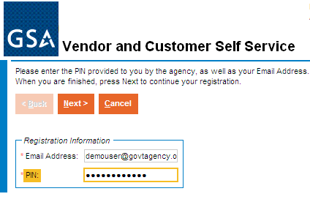
VCSS Registration Steps (Cont’d)
On the VCSS registration page, enter the following registration information:
Email Address you used to register on the GSA launch page’s registration form.
PIN provided in the approval email from GSA.
Select the [Next] button.
B12
Notes:
You can now enter the email address you used on the organization registration form and the PIN in the email from GSA.

Slide 14
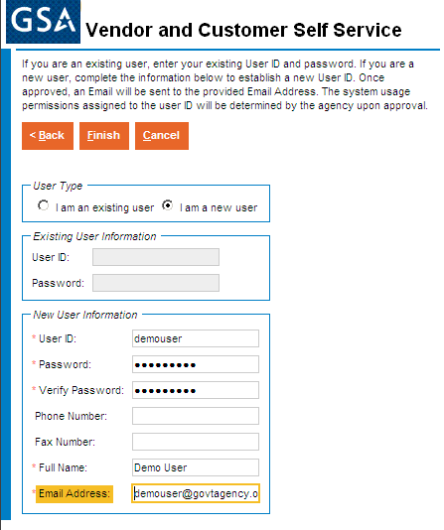
VCSS Registration Steps (Cont’d)
On the next screen of the VCSS registration page, enter the following new user information to have a User ID created:
User ID & Password provided in emails from GSA.
Your contact information.
Select the [Finish] button.
Note: If you are an existing user, in the User Type group box, select the I am an existing user radio button, fill out your User ID and Password, and then select the [Finish] button. For example, if you have already registered a VCSS account previously, you are an existing user since you already have a User ID.
B13
Notes:
Confirm the registration information in order to have a User ID login created for you to access the VCSS customer account you just registered.

Slide 15
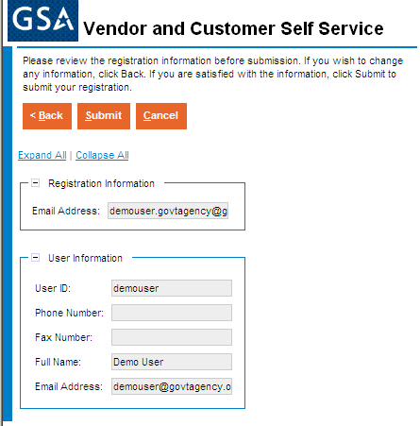
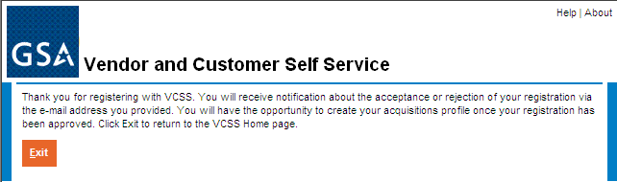
VCSS Registration Steps (Cont’d)
On the next screen of the VCSS registration page, review the registration information and then select the [Submit] button.
demouser@govtagency.
B14
Notes:
Submit the registration information in order to have a User ID login created for you to access the VCSS account you just registered.

Slide 16
VCSS Registration Steps (Cont’d)
GSA
After you submit the User ID registration, GSA reviews the User ID request for approval.
If GSA approves your User ID request, GSA will send you two separate emails containing your User ID and password.
If GSA does not approve your User ID request, GSA will send you an email stating the new User ID login request is rejected.
B15
Notes:
After you submit the registration information in VCSS, it is now in GSA hands to review your registration request and approve it.

Slide 17
VCSS Registration Steps (Cont’d)
Account Administrator
Go to the GSA launch page and select the option to Login to VCSS to verify your User ID and password.
B16
Notes:
You can only follow this step if GSA approved your registration request and sent you two emails with your new User ID login and password.

Slide 18
VCSS Registration Steps (Cont’d)
On the VCSS main page, select the Login hyperlink.
B17

Slide 19
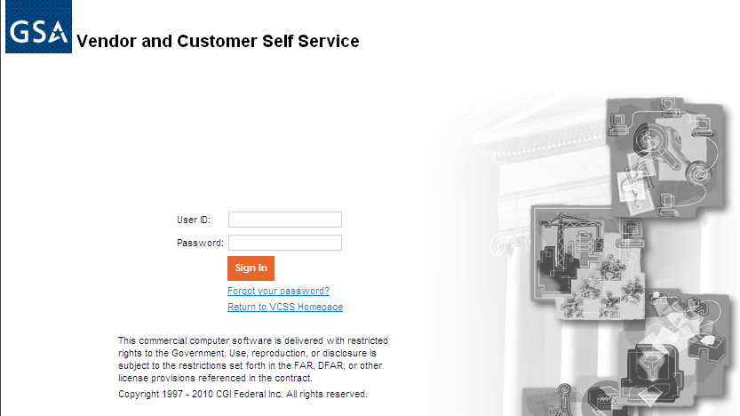

VCSS Registration Steps (Cont’d)
On the VCSS login page, enter your login information:
User ID and Password sent in two separate emails from GSA.
Select the [Sign In] button.
If your login to VCSS is successful, you now have access to the VCSS account you successfully registered for.
B18
Notes:
To login, enter your User ID and password sent in the approval email from GSA.
If the login is successful, you now have access to the VCSS customer account you just registered.

Slide 20

Request Access Overview
Request Access is the process you complete in order to request access to an existing VCSS account, which is an account that has already been registered in VCSS.
This process covers two scenarios:
A person needs a User ID to request access to a VCSS account for the first time.
A person already has a User ID and needs to request access to another VCSS account (account code).
Note: The account administrator is the person that registered the VCSS account. The customer is another person requesting access to a VCSS account and is not the account administrator.
B19
Notes:
We are now going to walk through the process of how to request user access to an existing VCSS account, which is an account that has already been registered.

Slide 21
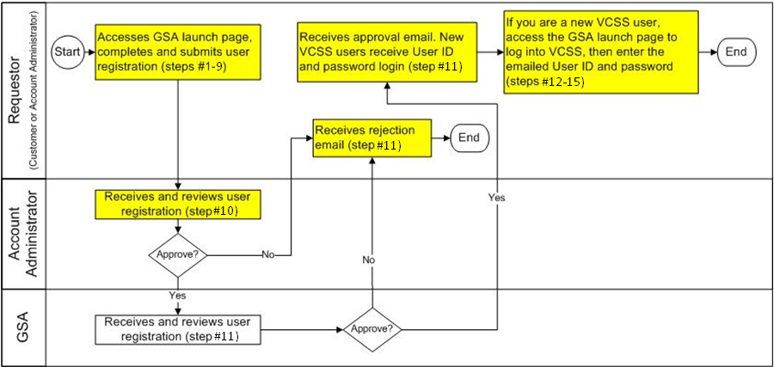
Request Access Process
This is the high level process diagram illustrating the steps to request access to an existing VCSS account.
B20
Notes:
This slide provides a high level overview of the steps taken to request access to a VCSS account. We are going to review the details for each step in this diagram in the next few slides.
Since the person requesting access can either be the customer or the account administrator, the process diagram uses the term “requestor” to refer to either of these two persons.
This is a process diagram for the request access process, which is organized with boxes and rows. Each box represents a step in the registration process. Each row is called a “swim lane” that lists the person responsible for each step.
First, the requestor, which can be the customer or account administrator that is requesting access, accesses the GSA launch page to complete and submit the user registration, which is covered in steps number 1 through 4.
Next, the account administrator, for the VCSS account you are requesting access to, receives and reviews the user registration for approval, which is covered in step number 5.
If the account administrator approves the user registration, then the access request is sent to GSA for approval.
However, if the account administrator does not approve the user registration, then the requestor receives a rejection email. Since the user registration has been rejected, the process ends here.
In the case that the account administrator approves the user registration, GSA then receives and reviews the user registration for approval, which is covered in step number 6.
If GSA approves the user registration, then the requestor receives an approval email from GSA.
However, if GSA does not approve the user registration, then the Requestor receives a rejection email from GSA. Since the user registration has been rejected, the process ends here.
In the case that the requestor receives an approval email from GSA, if you currently have a User ID, then the VCSS account that you requested access to is granted. If you do not have a User ID and are logging into VCSS for the first time, then GSA sends you a separate email with a User ID and password. You can access the GSA launch page to login to VCSS, and then enter your new User ID and password sent in the email from GSA, which is covered in steps number 7 through 10.

Slide 22
Request Access Steps
To request access to an existing VCSS account, perform the following steps covered in the next few slides.
As the person requesting access, go to the GSA launch page (http://vcss.gsa.gov) and select the Registrations and Access Request button to request access to an existing VCSS account.
B21
Notes:
As a customer or account administrator, you access the GSA launch page and go through the following steps.

Slide 23
VCSS Registration Steps (Cont’d)
On the GSA launch page, select the Click here if you are a Customer of GSA button to request access to a customer account.
B22

Slide 24
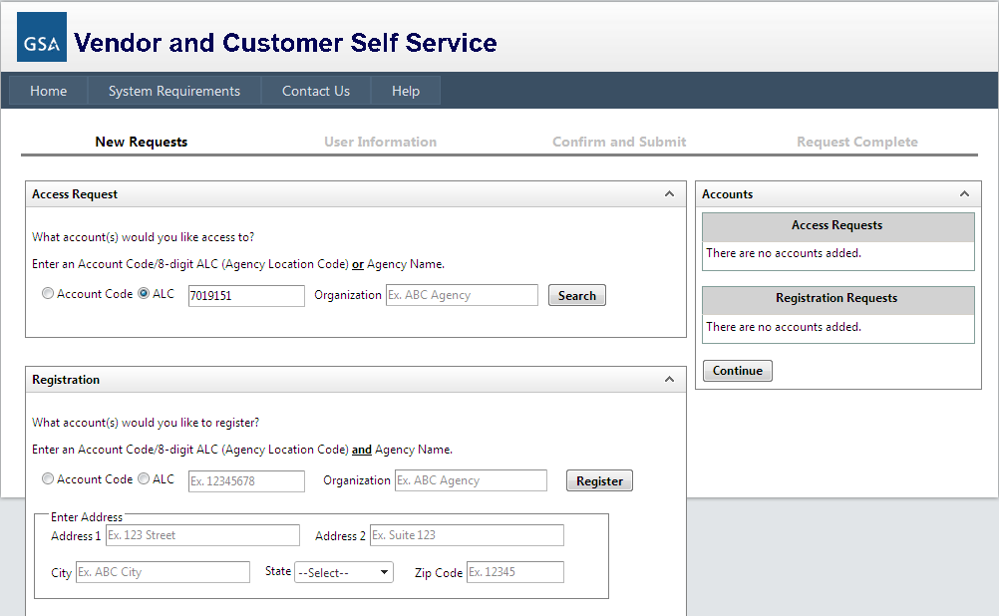
Request Access Steps (Cont’d)
On the next screen of the GSA launch page, search for the existing VCSS account that you would like to request access to. In order to search for VCSS accounts, enter the following search criteria to identify the account:
Account Code, ALC, or Organization.
Select the Search button to search for existing VCSS accounts.
Note: You may select more than one VCSS account to request access to.
B23
Notes:
If needed, you can request access to more than one account from this page.

Slide 25
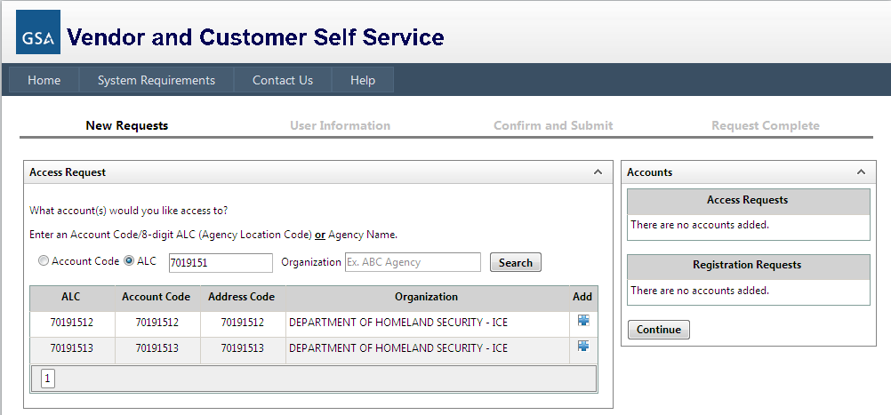
Request Access Steps (Cont’d)
Existing VCSS accounts matching your search criteria are returned.
Select the + symbol next to the account(s) you are requesting access to.
Note: You may select more than one VCSS account to request access to.
B24
Notes:
If needed, you can request access to more than one account from this page.

Slide 26

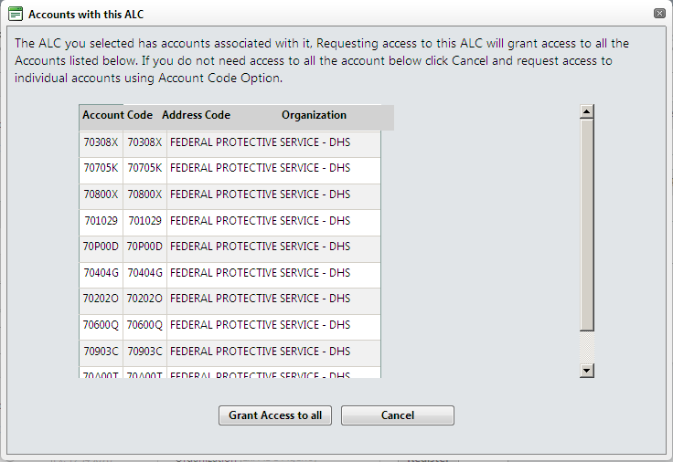
Request Access Steps (Cont’d)
Select the + symbol next to the account(s) you are requesting access to.
If the selected account is an ALC with multiple accounts associated with it, the “Accounts with this ALC” window is displayed.
If you need access to all accounts associated with the ALC, select Grant Access to all.
If you do not need access to all the accounts associated with the ALC, select Cancel and request access to an individual account using the Account Code option.
B25
Notes:
If needed, you can request access to more than one account from this page.

Slide 27
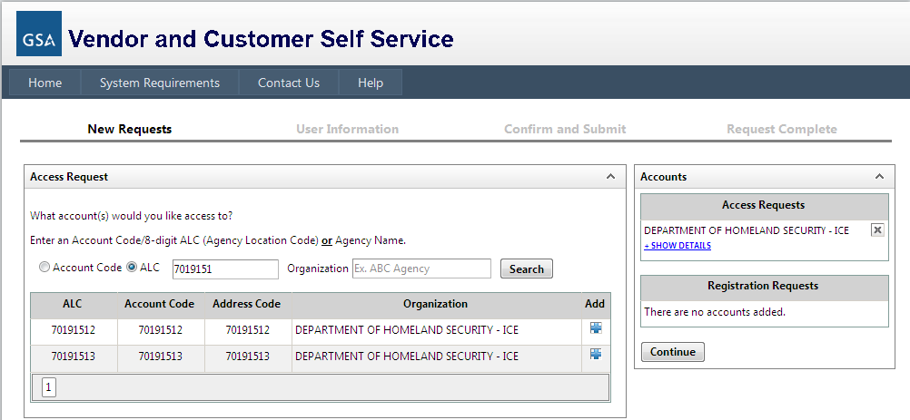
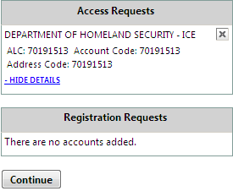
VCSS Registration Steps (Cont’d)
The Access Requests section is populated with the Organization Name(s) associated with the account(s) you selected.
Select +Show Details to view the details you entered for the registration.
Select the X to remove the account and start over.
Select the Continue button to continue the access request.
B26

Slide 28
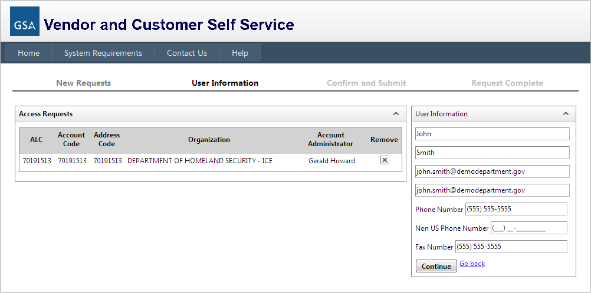
VCSS Registration Steps (Cont’d)
On the next screen of the GSA launch page, fill out the User Information to be associated with the access request.
Select the Continue button to continue the registration.
B27

Slide 29
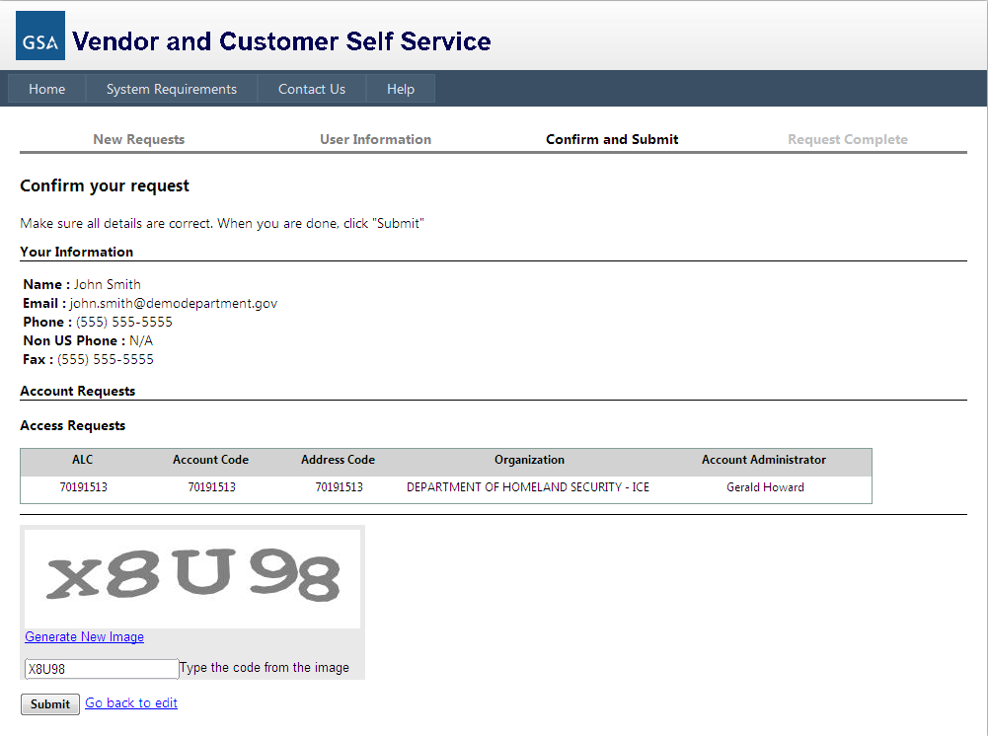
VCSS Registration Steps (Cont’d)
On the next screen of the GSA launch page, review the access request form.
At the bottom of the Confirm and Submit GSA Launch page screen, enter the code from the image and select the Submit button.
B28
Notes:
After you have filled out the organization registration form, you should verify the information that you entered is correct, and then submit the registration.

Slide 30

Request Access Steps (Cont’d)
Account Administrator
After submitting the access request, the account administrator is responsible for reviewing the access request for approval.
If the account administrator approves the access request, the access request is sent next to GSA for approval.
If the account administrator does not approve the access request, GSA cannot approve the access request.
The account administrator sends an access request rejection notification via email to the submitter.
B29
Notes:
It is now in the hands of the account administrator (of the account you requested access to) to review the access request for approval.
If you are the account administrator then you will receive this access request.

Slide 31
Request Access Steps (Cont’d)
GSA
After the account administrator approves the access request, GSA is responsible for reviewing and approving the access request.
If GSA approves the access request, GSA will do one of the following:
If you are requesting a User ID and access to a VCSS account for the first time, GSA will send you two separate approval emails containing your User ID and password.
If you are a customer or account administrator that already has a User ID and is requesting access to another VCSS account, GSA will send you one email stating the access request is approved.
If GSA does not approve the access request, GSA will send you an email stating the access request is rejected.
B30
Notes:
If the account administrator has approved the access request, GSA can review the access request for approval.
GSA reviews and approves the access request.

Slide 32
Request Access Steps (Cont’d)
Customer
If you have been issued a User ID and password but have not logged into VCSS for the first time, then follow steps 12-15.
Go to the GSA launch page (http://vcss.gsa.gov) and select the Login to VCSS option to verify your User ID and password.
B31
Notes:
If you already have a VCSS User ID, you can still access the GSA launch page to login to VCSS.

Slide 33
Request Access Steps (Cont’d)
On the VCSS main page, select the Login hyperlink.
B32

Slide 34
Request Access Steps (Cont’d)
On the VCSS login page, enter your login information:
User ID and Password sent in two separate emails from GSA.
Select the [Sign In] button.
If your login to VCSS is successful, you now have access to the VCSS account you requested access to.
Note: At this point, you should update your security questions. We will review this process later in the presentation.
B33
Notes:
On the VCSS login page, enter your User ID and password.

Slide 35
Support Request Overview
Support requests can be created from the GSA Launch Page.
The following types of support requests can be created:
Change Account Administrator
Remove Account
Remove from VCSS
Update User Profile
B34

Slide 36
Support Request Steps
To create a support request, perform the following steps covered in the next few slides.
Go to the GSA launch page (http://vcss.gsa.gov) and select the Support Request button to create a support request.
B35

Slide 37
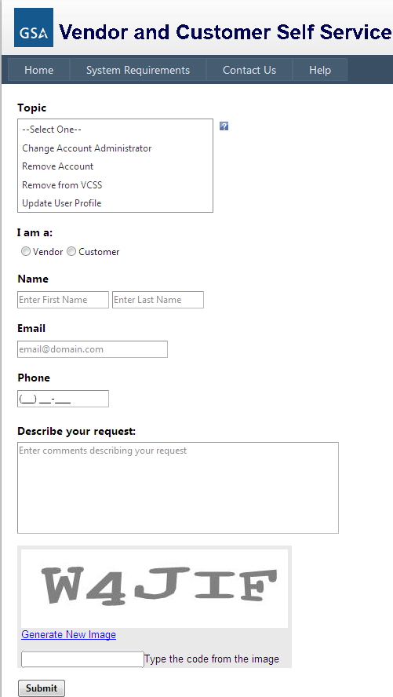
Support Request Steps (Cont’d)
Fill out the fields of the support request, including:
Topic:
I am a (Vendor or Customer)
Name (first and last)
Email
Phone
Describe your request
Enter the code from the image and select the Submit button.
B36

Slide 38
References
Return to the GSA VCSS Launch Page to access other segments of the VCSS presentation: http://vcss.gsa.gov.
Segment 1: Introduction
Segment 2: VCSS Account Registration & Requesting Access
Segment 3: Basic Navigation
Segment 4: Account Information
Segment 5: Statement and Dispute Information
Segment 6: Customer Payment Information
Segment 7: Correspondence Information
Segment 8: External Applications Information
B37
Notes:
This concludes segment 2 of the VCSS presentation.

